Slide 1
TESLA Stock Price Prediction LSTM vs GRU
Swetha Subramanian 205002111

Slide 2
Motivation:
Financial markets are dynamic, and accurate stock price prediction is valuable for investors and traders. LSTM and GRU, as advanced neural network architectures, offer the potential to capture intricate patterns in time-series data and improve prediction accuracy.

Slide 3
Introduction:
The stock market is characterized by complex and dynamic patterns, making accurate prediction challenging. Neural networks, specifically LSTM and GRU, are employed due to their ability to model temporal dependencies and learn from historical data. This study aims to leverage these architectures to forecast Tesla stock prices.

Slide 4
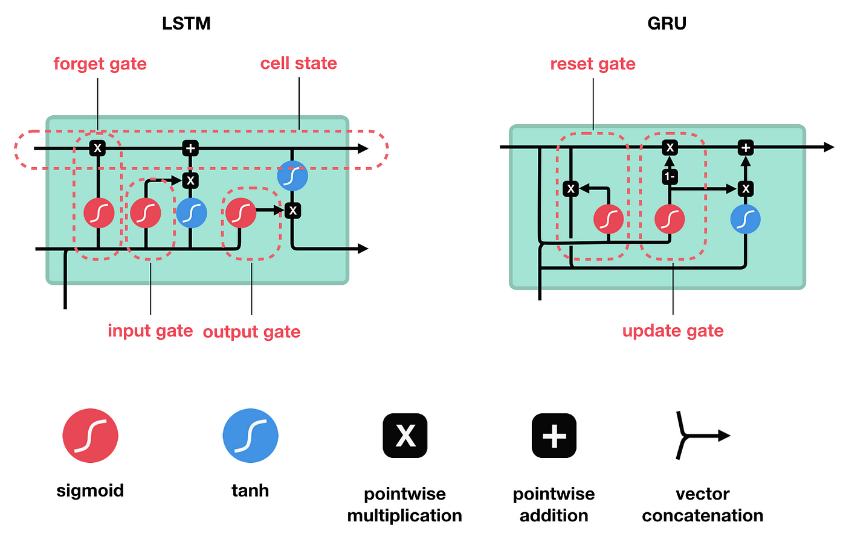

Slide 5
Workflow
Data Collection and Preprocessing:
Gather historical Tesla stock data.
Split the data into training and testing sets.
Model Development:
Implement LSTM and GRU models for stock price prediction. Train the models using the training dataset
Iterative Prediction:
Iterate over future time steps to predict multiple future stock prices.
Performance Evaluation:
Evaluate models based on metrics such as Mean Squared Error (MSE), Mean Absolute Error (MAE), and Root Mean Squared Error (RMSE).

Slide 6
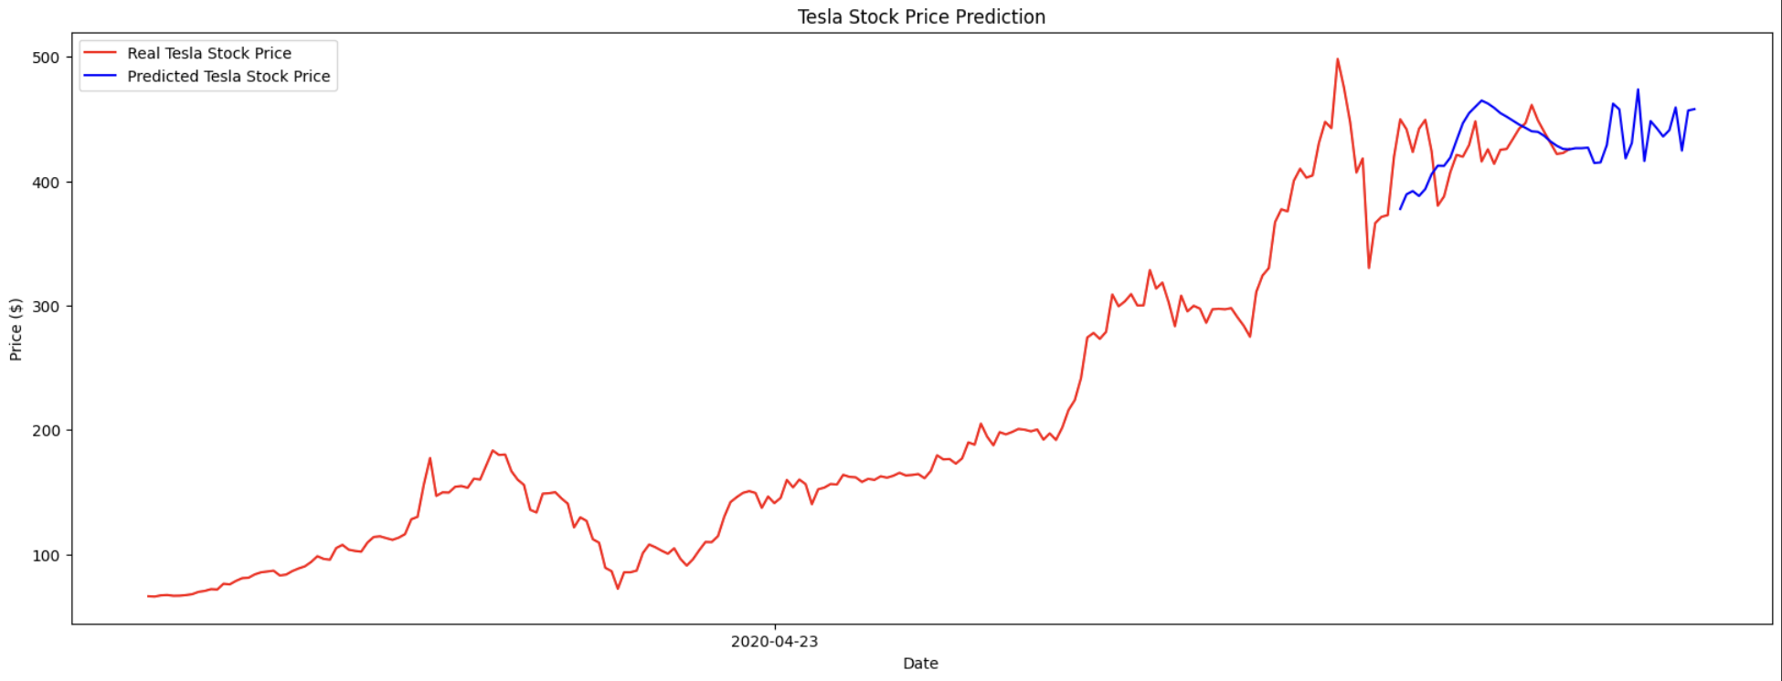
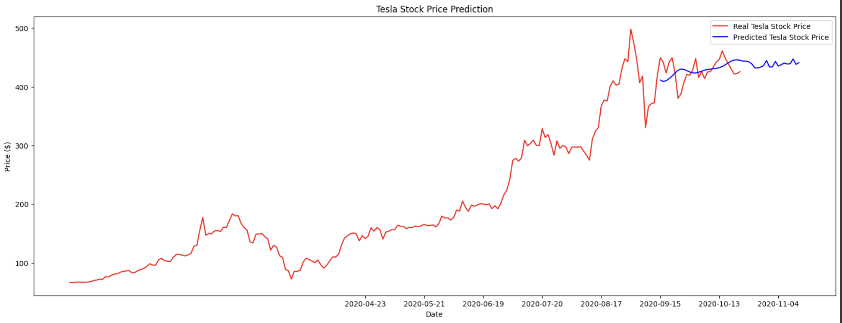
Result
LSTM
MSE: 959.7093530787853
MAE: 24.330810721261155
RMSE: 30.979176120077586
GRU:
MSE: 460.76398197982417
MAE: 17.060944431849887
RMSE: 21.465413622379238

Slide 7
Inference: GRU is better than LSTM
Simplicity and Training Speed:
GRUs have a simpler architecture compared to LSTMs. The reduced complexity may make them easier to train, converge faster, and potentially find a more optimal solution for the specific dataset. Simplicity can sometimes lead to better generalization, especially when the dataset is not very large.

Slide 8
Fewer Parameters:
GRUs have fewer parameters compared to LSTMs. This reduction in the number of parameters can be advantageous, especially when the dataset is limited. With fewer parameters, GRUs might be less prone to overfitting the training data, resulting in a better generalization to unseen data.

Slide 9
Task-Specific Patterns:
The specific temporal patterns present in the dataset may be well-suited to the gating mechanisms of GRUs. If the dataset has short-term dependencies and does not require the explicit long-term memory capabilities of LSTMs, GRUs might perform better.

Slide 10
Future Work
Enhancements:
Explore the use of more advanced architectures or ensemble methods. Investigate the impact of additional features on prediction accuracy.
Extended Applications:
Apply the models to predict stock prices of other companies. Explore the integration of external factors, such as market news and economic indicators.
Fine-tuning and Optimization:
Fine-tune hyperparameters for improved model performance. Optimize the models for real-time predictions and scalability.

